Slide 1
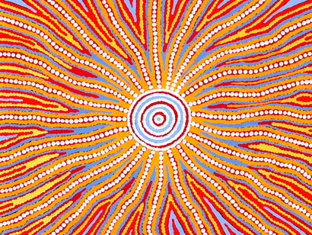
http://www.youtube.com/watch?v=l2TZ8cw-e24

Slide 2
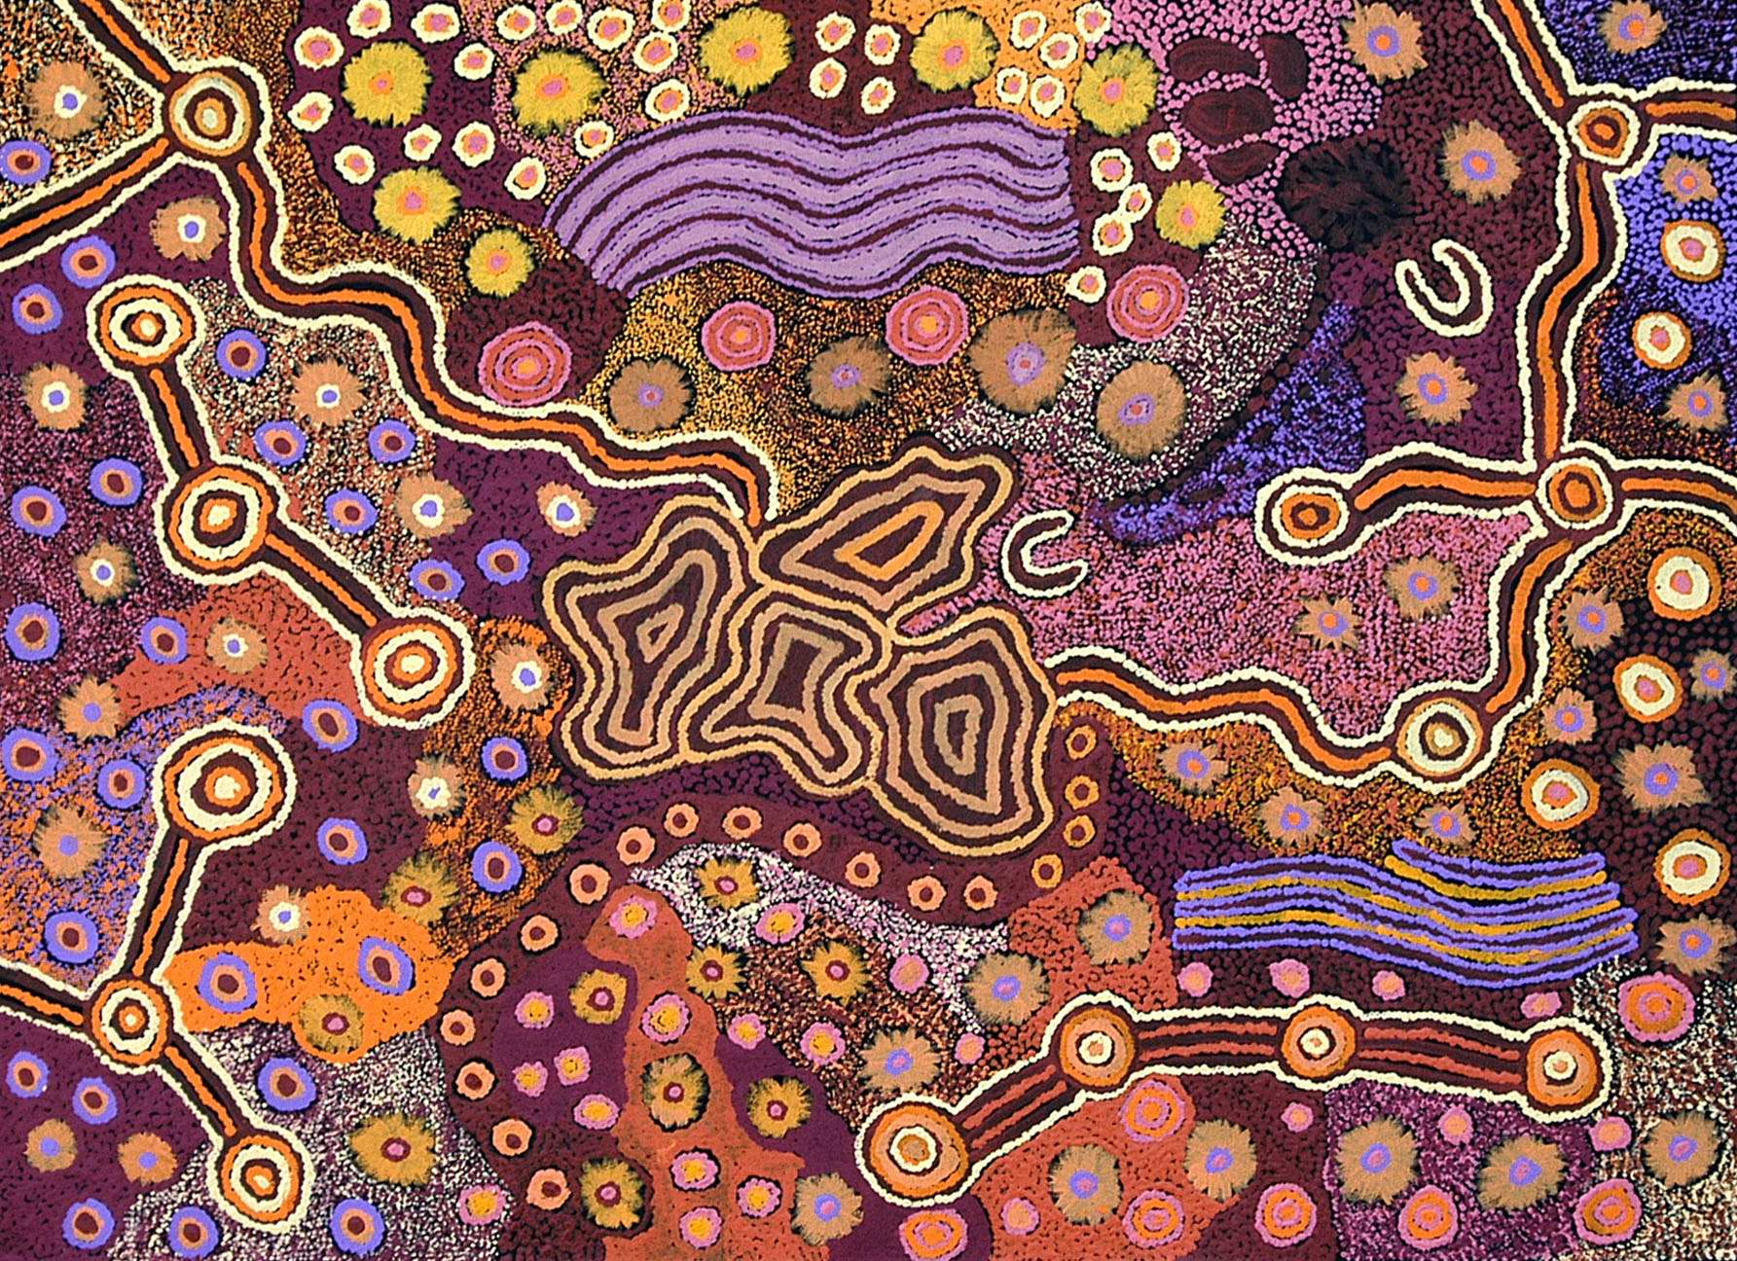
Aboriginal People of Australia
Australia's Aboriginal culture probably represents the oldest surviving culture in the world, with the use of stone tool technology and painting with red ochre pigment dating back over 60,000 years
The longest continuing religion in the world belongs to Australia's Aborigines, with the Rainbow Serpent mythology recorded in rock shelter paintings believed to be 7,000 years old, this Ancestral Being is still important to local people.
Notes:
Chipping away at the edge of a rock to make a sharp edge

Slide 3
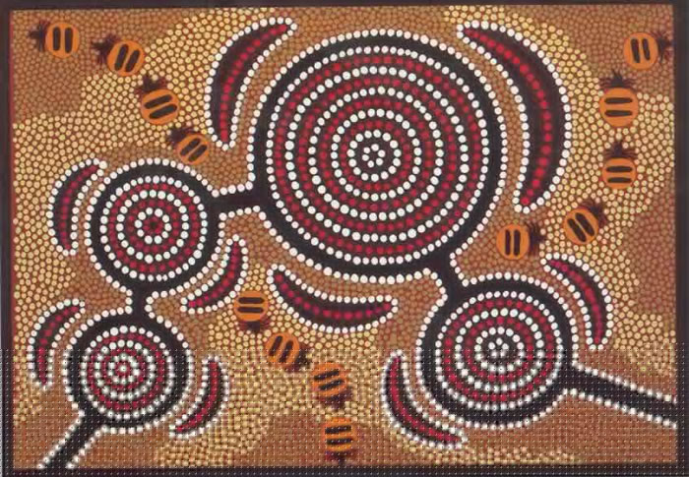
Aboriginal Art
Aboriginal art is based on important ancient stories and symbols centered on 'the Dreamtime' – the period in which Indigenous people believe the world was created.
The Dreamtime stories are up to and possibly even exceeding 50,000 years old, and have been handed down through the generations virtually unchanged for all those years.

Slide 4
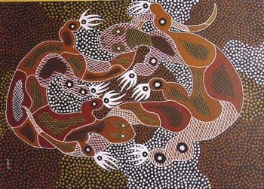
The Dreamtime Rainbow Serpent Story
In the Dreamtime all earth lay sleeping. Nothing moved. Nothing grew. One day the Rainbow Serpent awoke from her slumber and came out from under the ground.
She travelled far and wide and eventually grew tired and curled up and slept. She left marks of her sleeping body and her winding tracks. Then she returned to the place where she had first appeared, and called to the frogs, “Come out!”
The frogs came out slow because their bellies were heavy with water, which they had stored in their sleep. The Rainbow serpent tickled their stomachs and when the frogs laughed, water ran all over the earth to fill the tracks of the Rainbow serpents’ wanderings. This is how lakes and rivers were formed.
With water, grass and trees sprang up. Also all animals awoke and followed the rainbow serpent across the land. They were happy on earth and each lived and gathered food with his own tribe. Some animals live in rocks, others on the plains and others in trees and in the air.
The Rainbow Serpent made laws that they all were to obey, but some became quarrelsome and made trouble. The Rainbow Serpent said,” Those who keep my laws will be rewarded; I shall give them human form. Those who break my laws will be punished and turned to stone, never to walk the earth again.
The lawbreakers became stone and turned to mountains and hills, but those who kept the laws were turned into human form. The Rainbow Serpent gave each of them their own totem of the animal, bird or reptile from whence they came. The tribes knew themselves by their totems. Kangaroo, emu, carpet snake, and many, many more. So no one would starve, the Rainbow Serpent ruled that no man should eat of his totem, but only of other totems. This way there was food for everyone.
The tribes lived together on the land given to them by the Rainbow Serpent or Mother of Life and knew the land would always be theirs, and no one should ever take it from them.

Slide 5
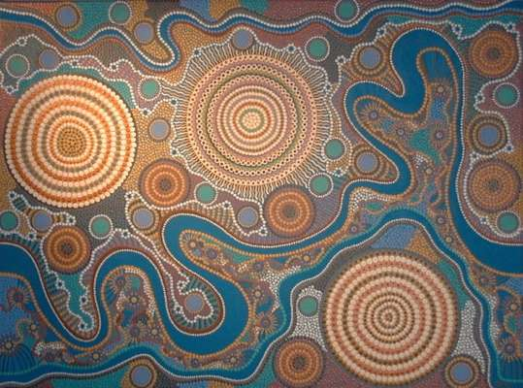
Aboriginal art also stands as a written language:
It is a major part of the unwritten 'encyclopedia' of being an Aboriginal person and it may have many layers of meaning.
Australian Aboriginal people have no written language of their own, and so the important stories central to the people's culture are based on the traditional icons (symbols) and information in the artwork, which go hand in hand with recounted stories, dance or song, helping to pass on vital information and preserve their culture.

Slide 6
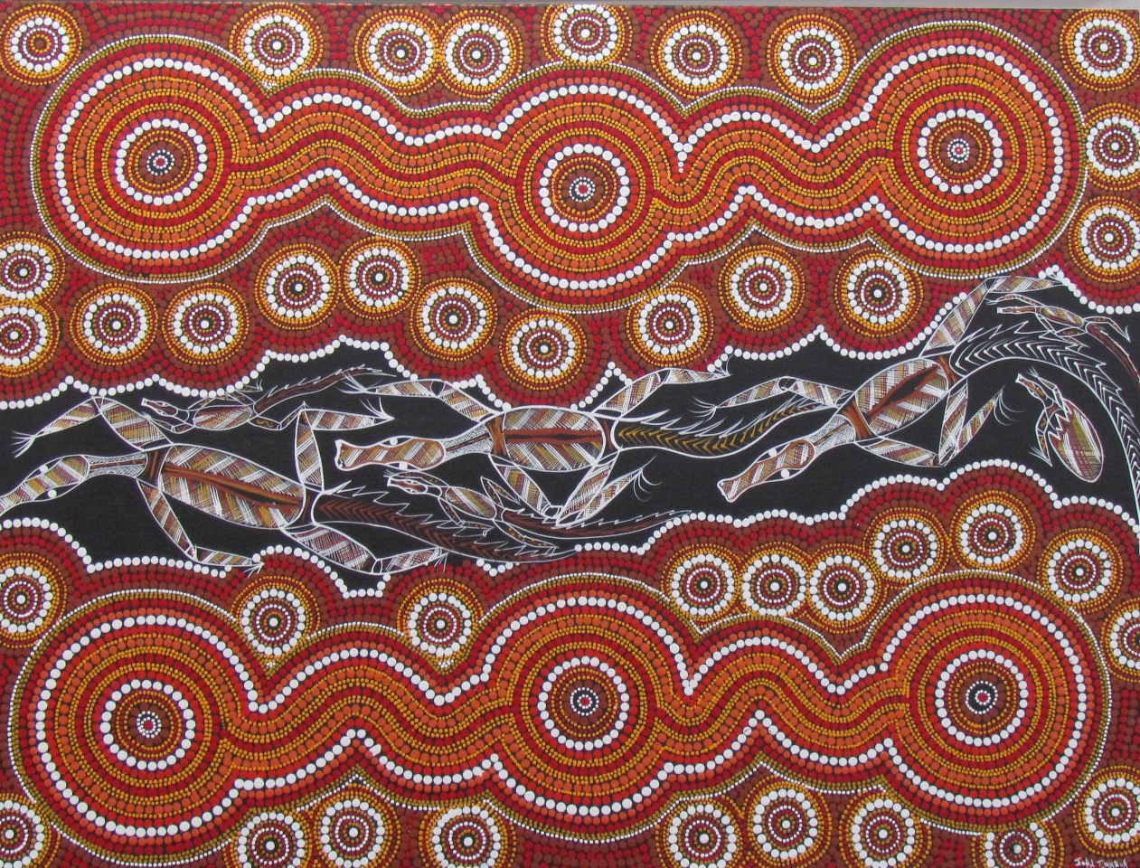
Paintings are also used for teaching:
A painting (in effect a visual story) is often used by the aboriginal people for different purposes, and the interpretations of the iconography (symbols) in the artwork can vary according to the audience.
The story may take one form when told to children, and a very different and higher level form when speaking to initiated elders.
The stories behind many of the artworks when related to children have a strong educational and behavioural aspect
  Somewhat like Aesops Fables where there can be information and/or a moral to the story where good or bad behaviour and consequences are highlighted.

Slide 7
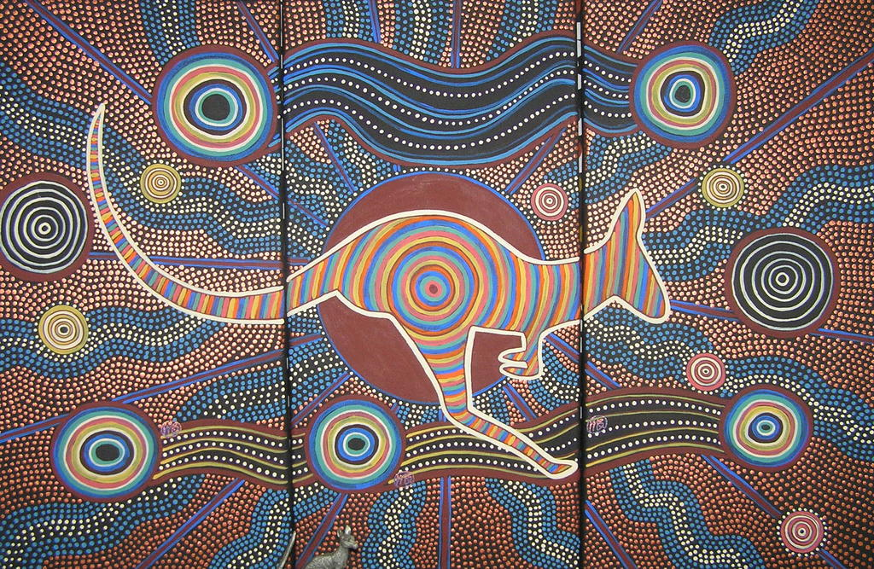
Artists need permission to paint a particular story:
Where ancient and important stories are concerned, and particularly those containing secret or sacred information, an artist must have permission to paint the story she or he paints.
Traditional Aboriginal artists cannot paint a story that does not belong to them through family lineage.

Slide 8
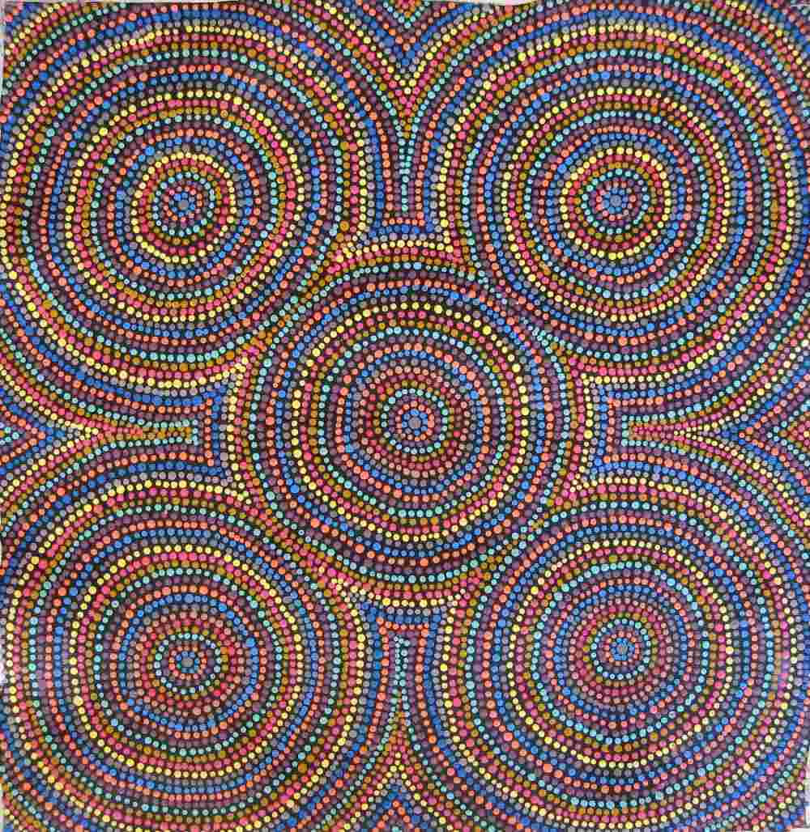
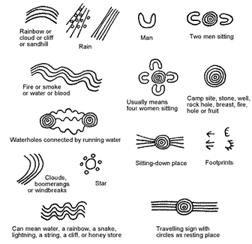
Symbols
While the most commonly used symbols are relatively simple, they can be used in elaborate combinations to tell more complex stories

Slide 9
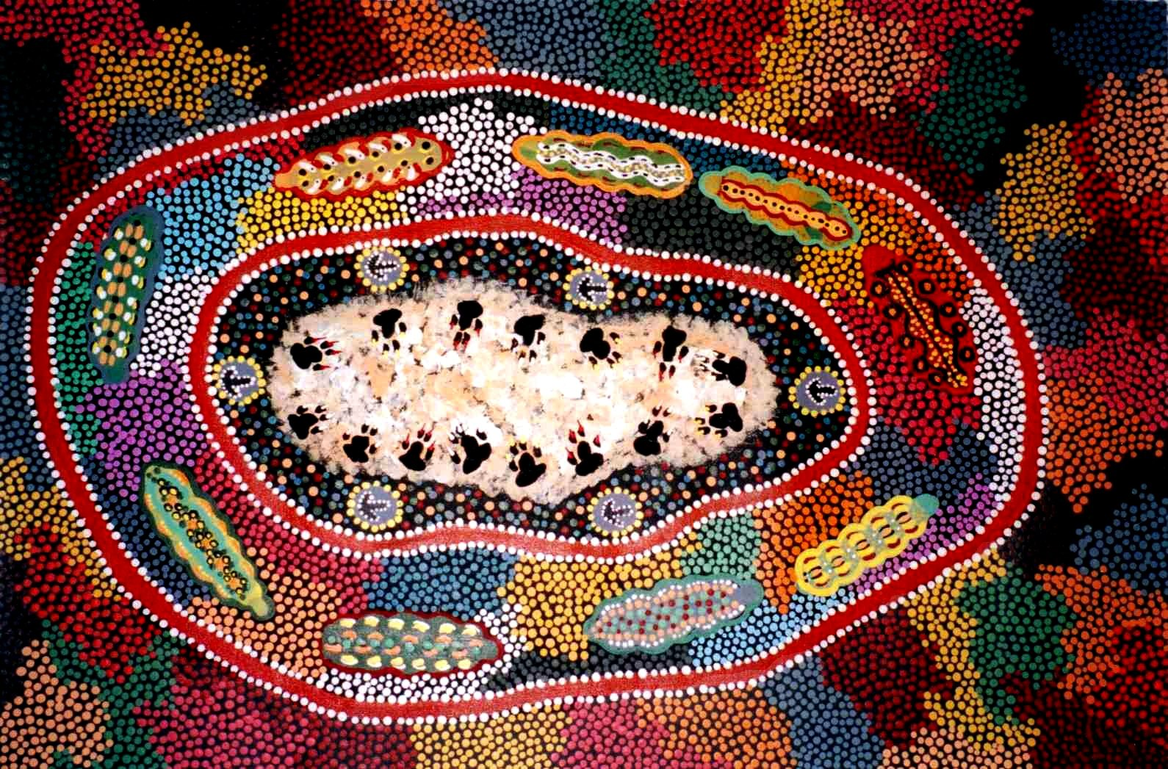
Dotting
Johnny Warangkula was one of the 1st artists to use dotting as the background for his paintings
Dots are one of the conventional symbols used and are what give a lot of Aboriginal art its character
  Ironically, dotting began to be used to obscure some meanings and hide some of the symbolism that was not meant to be exposed to the un-initiated

Slide 10
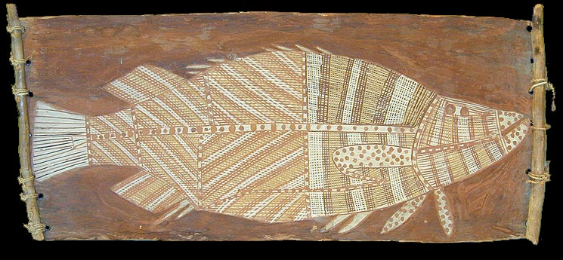
Painting on Bark
The oldest form of Aboriginal art but many bark paintings have perished over time.
Not only is the bark prone to decay and disintegration, but the ochre paints used also have a relatively short life.

Slide 11
Assignment
Draw a sketch of an animal, or design you would like to use for your Aboriginal art creation, you may also use the internet for inspiration
Lightly draw your final image onto a piece of 8 ½ X 11 paper
You will then fill in the image and the negative space around it with dots, symbols and designs used in Aboriginal art

Slide 12
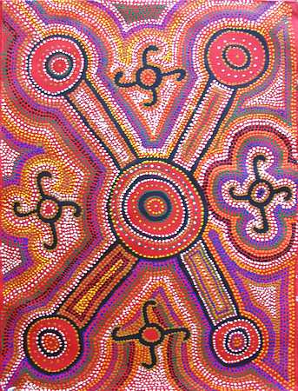

Slide 13
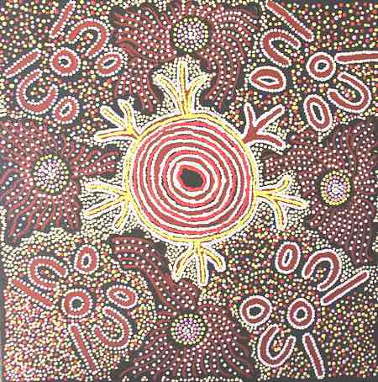

Slide 14
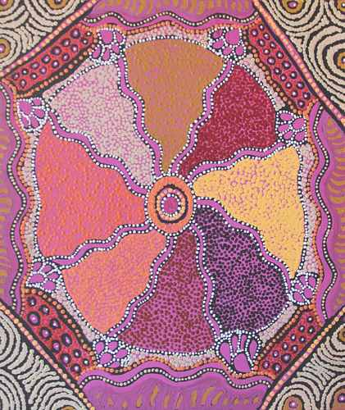

Slide 15
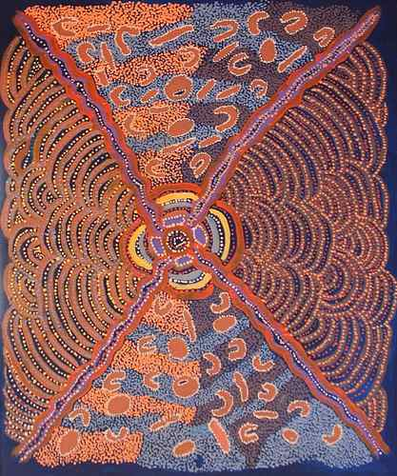

Slide 16
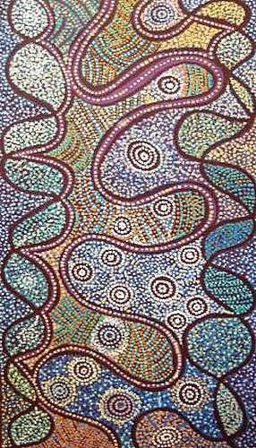

Slide 17
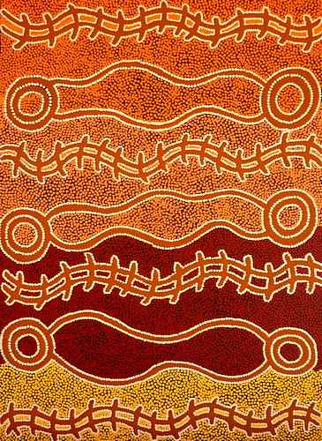

Slide 20
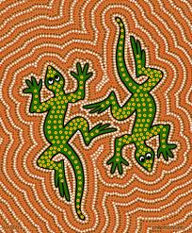

Slide 21
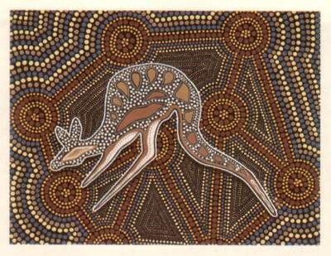

Slide 22
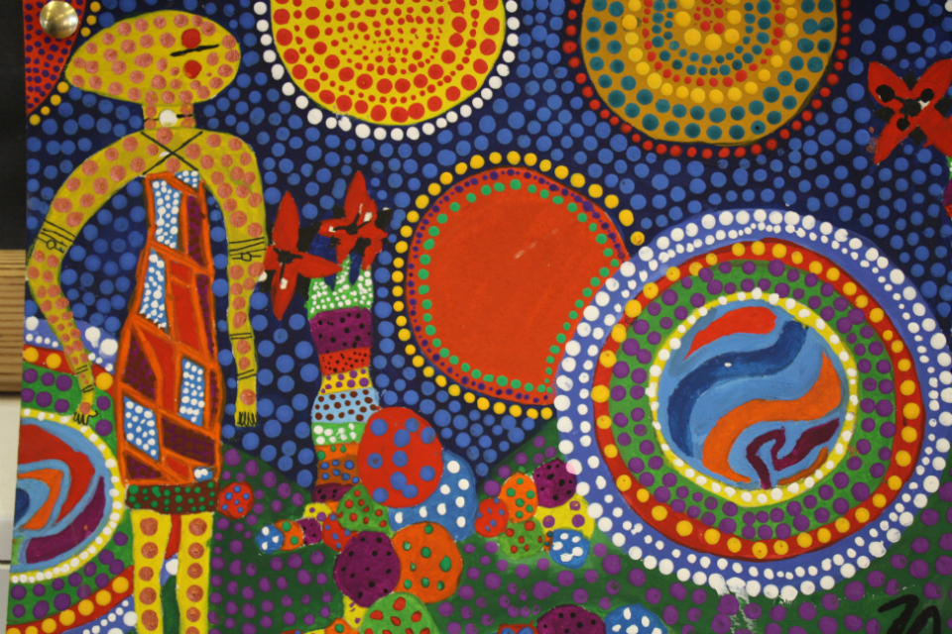

Slide 23
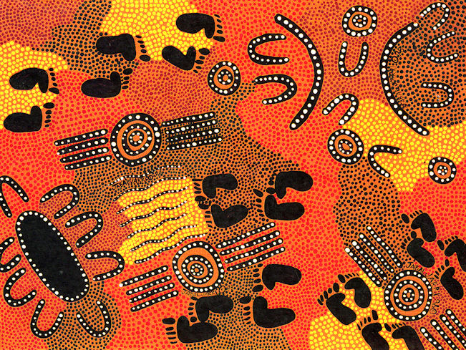

Slide 24
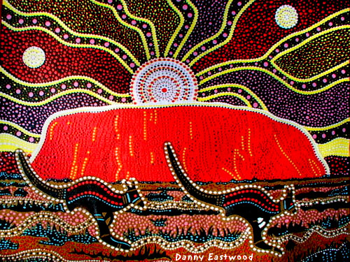

Slide 25
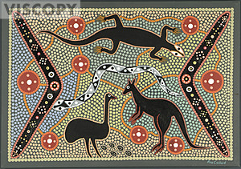

Slide 26
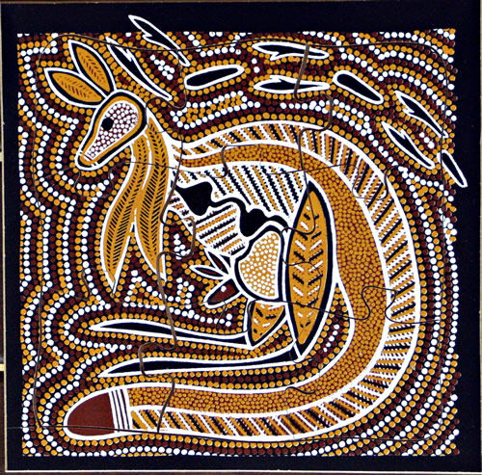

Slide 27
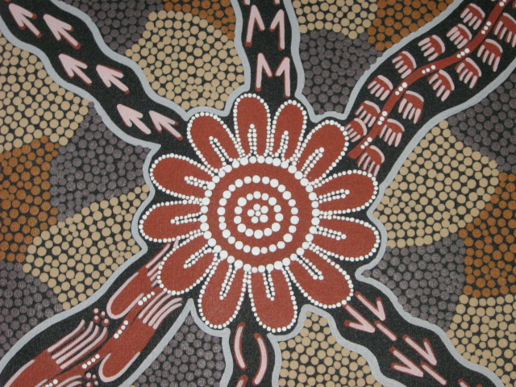

Slide 28
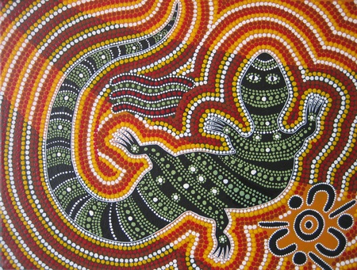

Slide 29
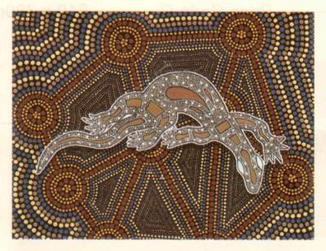

Slide 30
